Slide 1
Real Time Interpolation for Deep sea AUV Data
Dev Saxena

Slide 2
Motivation
More than 80% of the ocean floor remains unexplored
Studying seabed topography helps us understand the climate system
Exploration of seabed resources
Notes:
Read off the slides
Cost is a massive factor, more time spent on the seabed in one mission, the better (fewer dives)
There’s a lot we can learn from exploring the deep sea

Slide 3
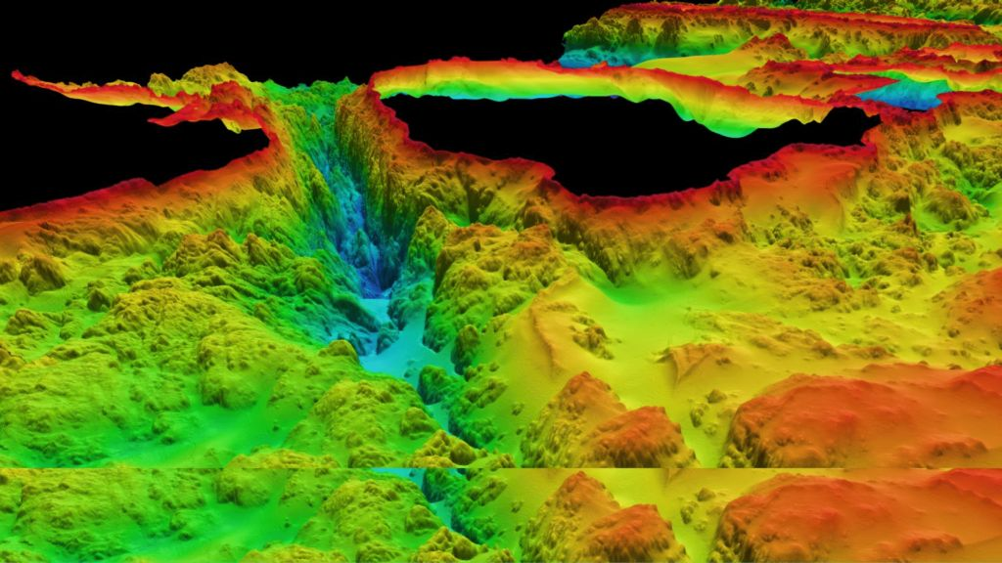
Bathymetry data
Measurement of the depth of the seafloor, similar to elevation on land
Notes:
This is the type of data I’ll be focusing on
Best data to represent mapping of the sea floor
Pretty accurate

Slide 4
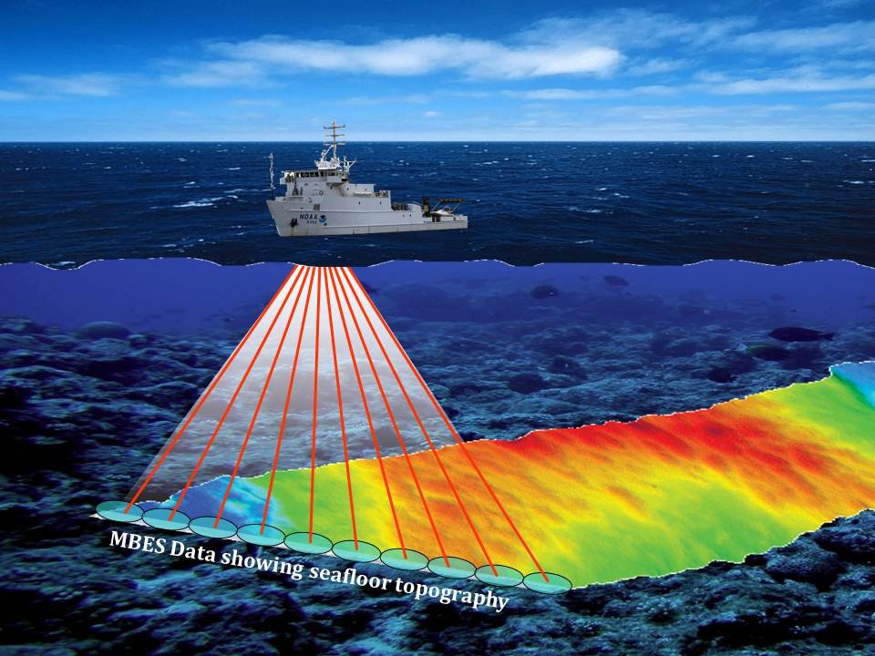
How AUV’s Collect Data
Multibeam echosounder mounted to bottom of ship
Emits sound into the water, hits seafloor, echoes back
Notes:
Explain sonar, how time and frequency of the returned signals help us calculate
Multibeam is a fan of outbound signals, more accurate and greater resolution than single beam

Slide 5
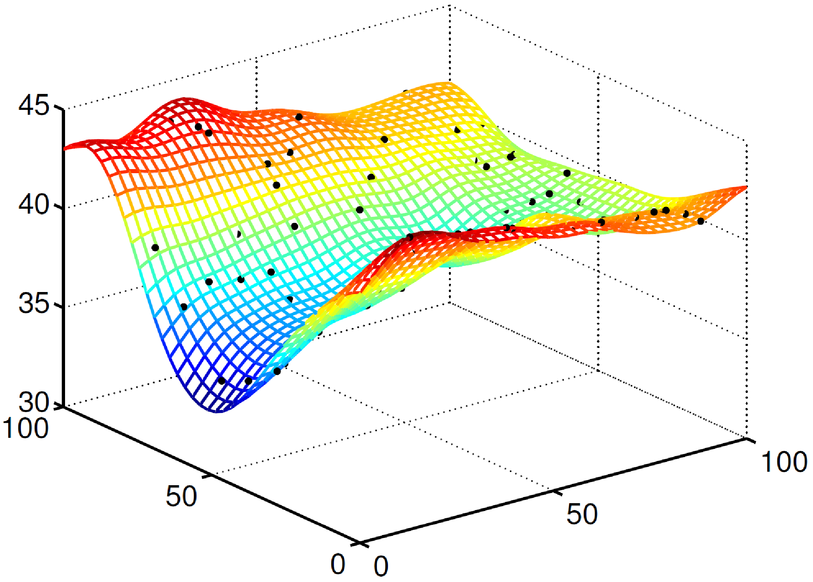
interpolation
Spatial technique that uses a limited number of data points to estimate other values
Notes:
Interpolation constructs new data points based on a known discrete set of points
Many different techniques: Spline, inverse distance weighted, and the one we will use is called kriging
After initial collection of data, we can increase resolution, construct mapping, and fix original points with the help of interpolation

Slide 6
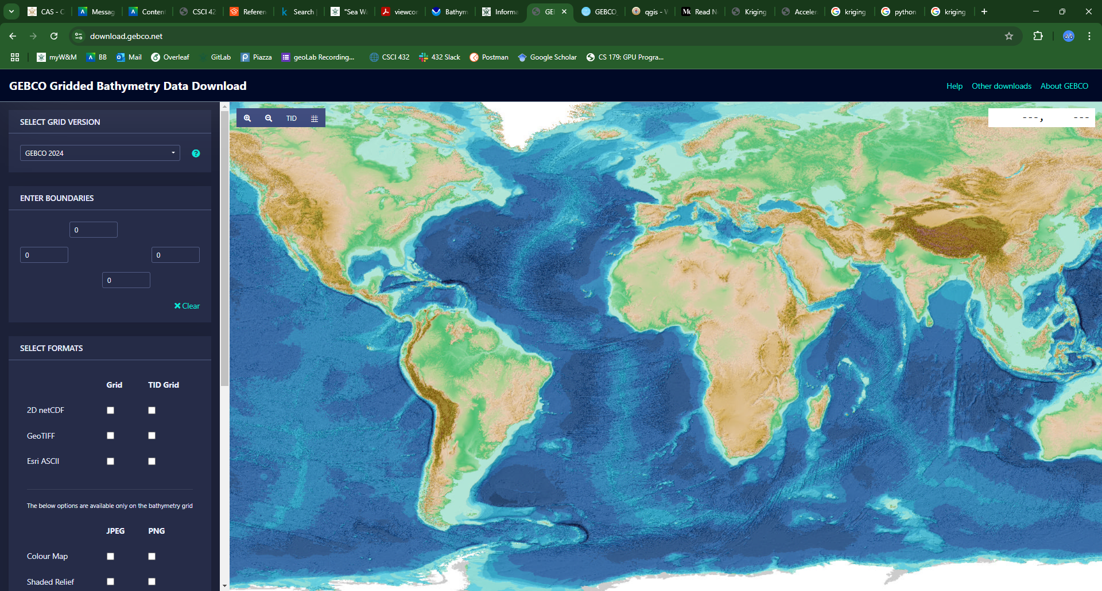

Slide 7
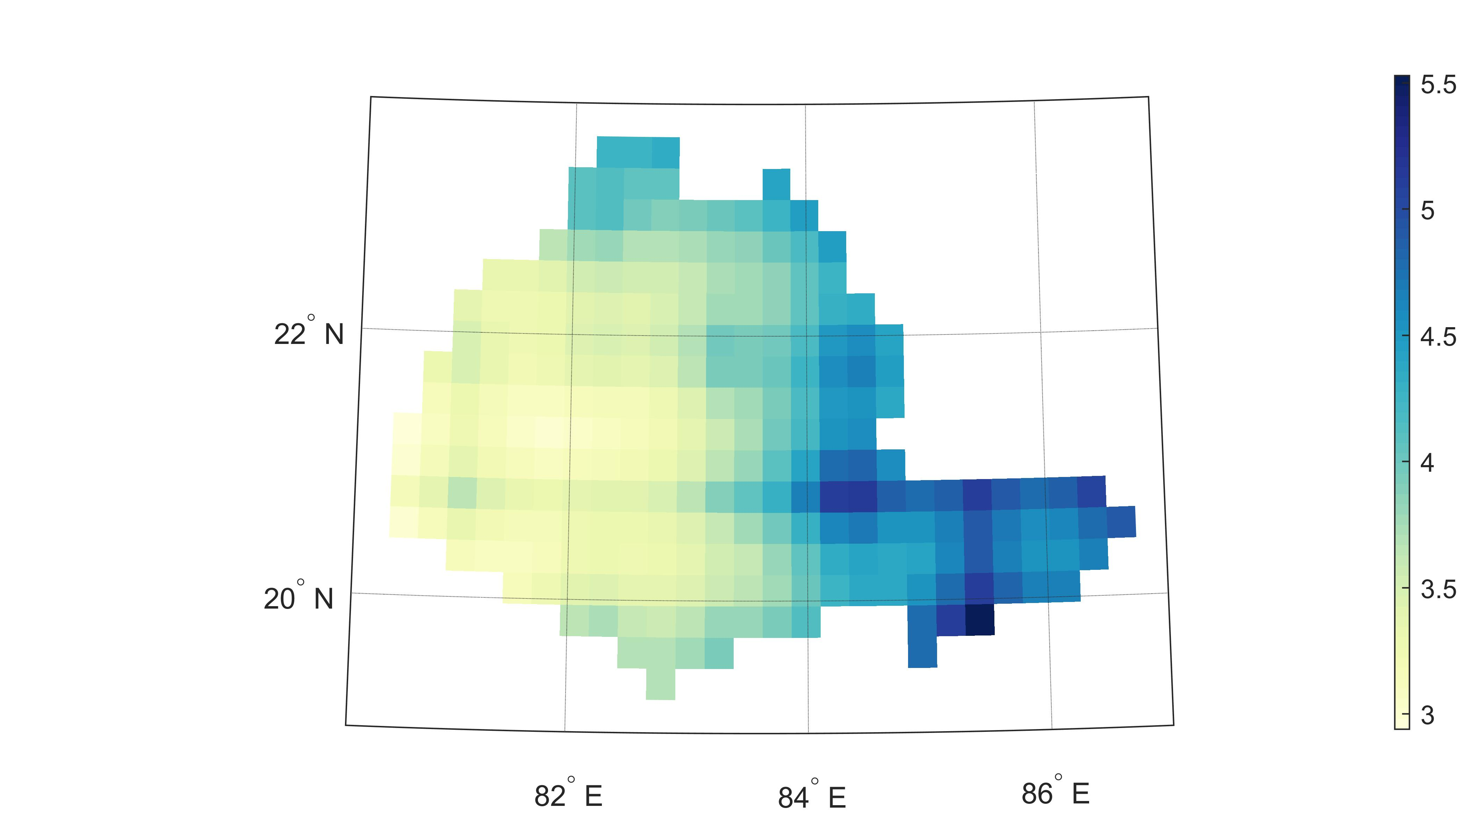
Notes:
Data is arranged into rasters (grids)

Slide 8
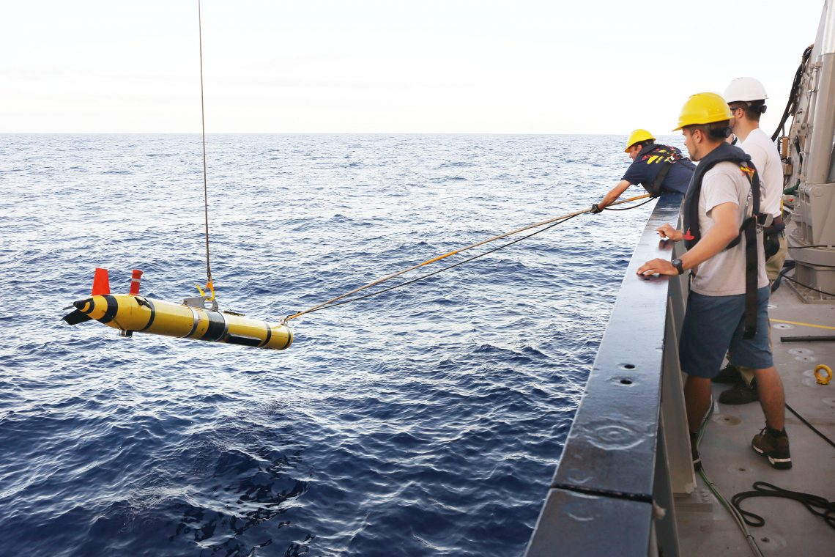
Current Data Processing
AUV needs to surface to offload data
Interpolation is computationally expensive
Notes:
AUVs and ROVs need to resurface in order to offload their data, which is then processed on land or on the mother ship
Dives and resurfacing is expensive/risky
If we could perform all the computation on the AUV itself, it could do longer missions and increase mission performance

Slide 9
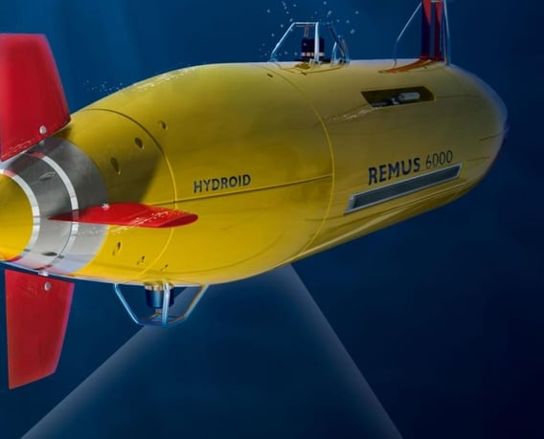
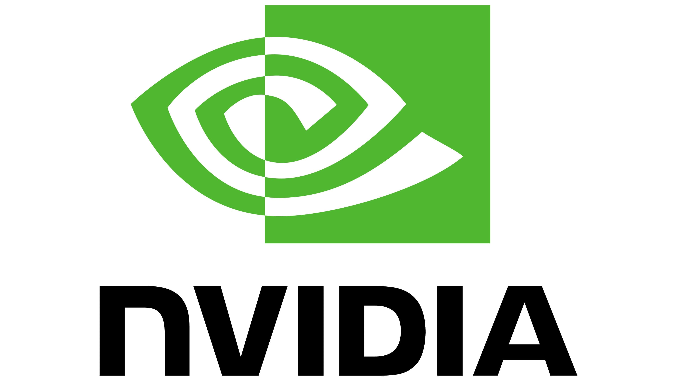
Real time processing
GPU implementation with hardware on the AUV
Saves mission time and money
Notes:
The way to do this is by parallelizing the computation -> GPU’s!!
The hardware is cased and protected on the AUV so that it can run correctly
Has already been done by company called Greensea IQ who ran ML models on their AUVs

Slide 10
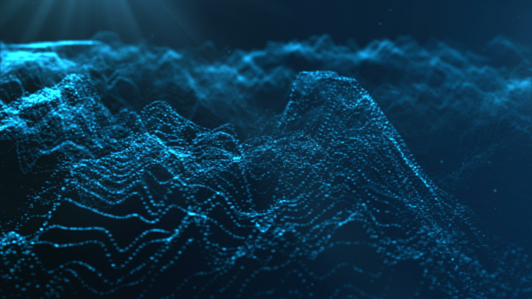
benefits
Dynamic mission planning
Less data transmission
Improved navigation
Notes:
As mentioned before, this real time interpolation would have many benefits

Slide 11
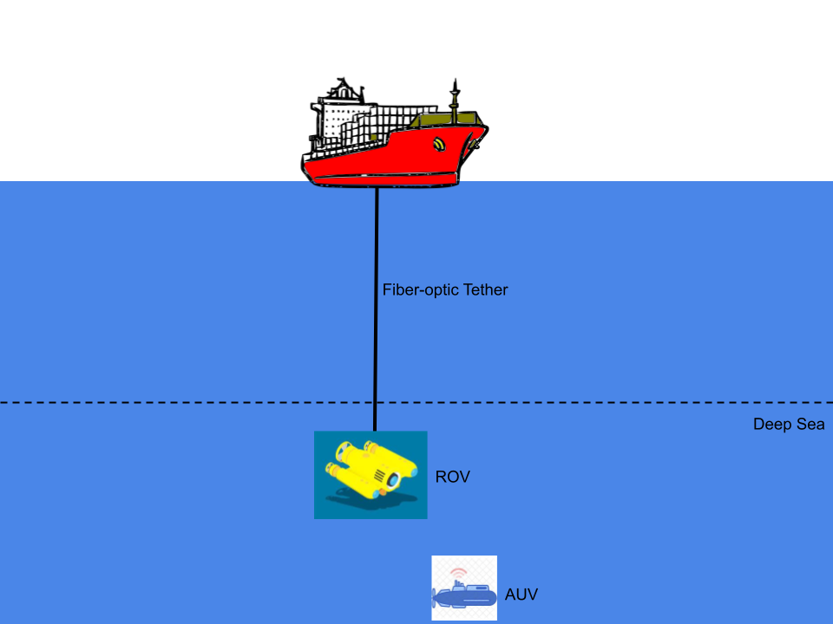
Final Architecture
Notes:
Finally, here is a diagram of what a possible mission model could look like
The only communication between ROV and AUV would be critical stuff like location which needs to be reported to humans on the mothership

